Slide 1



Intelligent Automation Systems Pvt. Ltd.
WORKS & OFFICE ADDRESS
111, Shiv Sagar Industrial Estate,
Kotkar Road,
Goregaon (East),
Mumbai-400063
E-mail ID : - fsoias@gmail.com
Phone: +91-22-29275926, 29275928
Fax: +91-22-29275925

Slide 2

















~Intelligent Automation Systems Pvt. Ltd.~
Offers Turnkey Automation Solutions for process industries.
Offers Engineering, Procurement and Commissioning Services
Offers Erection and Commissioning Services
Offers Engineering Inspection Services
Our Clients :

Slide 3
Registrations
Company PF No : MH – 90525
Professional Tax No : 27130396946P
Pan no. (income tax) : AAACI1947B dated 05/02/1991
Service tax no : AAACI1947BST001 w.e.f. 10.12.2004
T. A. N. no : MUMI04821F
Central Excise Reg. no : AAACI1947BXM001 w.e.f. 07/06/2005
VAT no : 27130396946V w.e.f. 01/04/2006
CST no : 27130396946C w.e.f. 01/04/2006
I.E.C. no : 0399023879 dated 06/09/2004
NSIC Registration No. :NSIC/MUM-AD/GP/RS/I-09/MH
Electrical License No. :27462 DATED 16.07.2012
NSIC-ONICRA Rating :SE-2A From Date 26.07.2012

Slide 4
Directors
H.S. Patwardhan
V.L. Joshi
Organization Chart
Head Engg. Design
Mr. R.R Save
Engr & Designer
Mr. Harish
Mr. Manik
Mr. Vijay
Mr. Varun
Mrs. Sujata
CAD Draftsmen
Mrs. Aruna
Ms Prachi
Mr. Prashant
Mr. Rakesh
Material Manager
Mr. Prashant
PLC/SCADA/DCS
Manager
Ms Manasee
Erection Manager
Mr. T.B. Nair
PLC/SCADA
Engineer/
Desginer
Mr. Girish
Mr.Varun
Mr. Gaurish
Mr. Vaibhav
Project Site Engr
Mr. Abhay Gupta
Mr.Vasant Salvi
Mr. Shriram
Mr. Sushant
Mr. Sandeep
Electricians
30 Nos
Exp 2-10 years
Fitters
30 Nos
Exp. 4-10 years
Welders
6 Nos
Exp 2-8 years
Instrument Technician
6 Nos
Exp 2-8 years

Slide 5



PIPELINE PROJECTS (LPG & NATURAL GAS)
Sr. no. | Project Name | Client
1. | LPG pipeline to HPCL bottling plant Rajahmundry-E & I System, ( Engineering and Turnkey Contract)
2. | Dahej-Uran Natural Gas pipeline DUPL Spread – III (Turnkey Basis Instrumentation Package involving 8 PLC Based Local Stations with HMI interface )
3. | Bakhrabad-Siddhirganj pipeline project, Bangladesh (Project management consultancy – Instrumentation, PLC and SCADA)
4. | PAGUTHAN-NTPC JHANORE pipeline project (Project management consultancy – Instrumentation & SCADA)
5. | Dhanora TAP off IOCL pipeline project for Gujrat state Petronet Ltd. (Project management consultancy – Instrumentation & SCADA)
6. | GSPL Cairn Mora gas pipeline project(Project management consultancy – Instrumentation & SCADA)

Slide 6


PIPELINE PROJECTS (LPG & NATURAL GAS)
Sr. no. | Project Name | Client
7. | IOCL Lube oil Pipeline IOCL-IOBL, Trombay (SCADA System-Turnkey Project)
8. | Kalol-Mehesana Natural Gas Pipeline project (Project management consultancy – Instrumentation & SCADA)

Slide 7
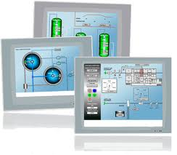
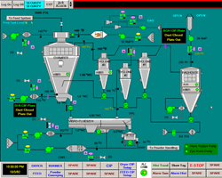
Control and SCADA System
PLC based control system with open architecture
Integration of process control system with enterprise system
Customised recipe based batch process management system
Application based on VFDs and soft starter ,utilities Pipelines
and power system monitoring SCADA system

Slide 8
Control System and SCADA projects
Sr. no. | Project Name | Client
1. | BASF, Turbhe (Effluent treatment plant) E & I Turnkey with PLC and SCADA
2. | Ministry of housing, Electricity & water sultanate of Oman(MSSI) PLC , SCADA Engineering and supply Water Supply to Bahla Wilayat. Water Supply to Ash Sharqiyah. Water Supply to BID-BID FANJA and Cities around Water Supply to Liwa, Saham, Khaburah and Shinas Water Supply to Al Amirat
2. | IOCL Silvassa (Automation of Oil blending plant)
3. | IOCL Kolkata (Automation of Oil blending plant)
4. | IOCL Sahar (Aviation fuel Pressurized Hydrant Automation)
5. | IOCL Trombay (Automation of Oil blending plant)

Slide 9
Control System and SCADA projects
Sr. no. | Project Name | Client
6. | LPG pipeline to HPCL bottling plant Rajahmundry-E & I System, (Engineering and Turnkey Contract)
7. | Dahej Uran Natural Gas pipeline DUPL Spread – III (Turnkey Basis Instrumentation Package involving 8 PLC Based Local Stations with HMI interface )
8. | Bakhrabad Siddhirganj pipeline project, Bangladesh (Project management consultancy – Instrumentation, PLC and SCADA)
9. | PAGUTHAN-NTPC JHANORE pipeline project (Project management consultancy – Instrumentation & SCADA)
10. | Dhanora TAP off IOCL pipeline project for Gujrat state Petronet Ltd. (Project management consultancy – Instrumentation & SCADA)
11. | GSPL Cairn Mora gas pipeline project(Project management consultancy – Instrumentation & SCADA)

Slide 10

Control and SCADA projects
Sr. no. | Project Name | Client
12. | FMC, Hyderabad -E& I System, (Engineering and Turnkey Contract including PLC-SCADA system)
13. | H.B.Fuller Adhessive India Pvt Ltd,(Specialty Adhesive plant) (turnkey Instrumentation with Multi PLC-SCADA control system)

Slide 11



EPC Contracts
Sr. no. | Project Name | Client
1. | Rallies India Limited (Acephate Plant, Lote, Maharashtra)
2. | Indian oil Corporation Limited, Grease plant, Navi Mumbai Small Scale Grease Plant New Thermic Fluid Heater New Oil Cooler
3. | BG Exploration and Production India Limited Shore base Facility
4. | Organic Waste India Pvt. Ltd., Navi Mumbai 1000 TPD MSW Processing Facility Project, Mandur, Banglore
5. | Reliance Limited. Patalganga (PSA Hydrogen Purification plant / PTA Pneumatic conveying ) –Engineering , Errection and Supply of PLC Based PlC HMI Interfaced Control System

Slide 12

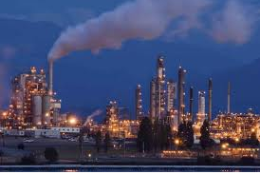
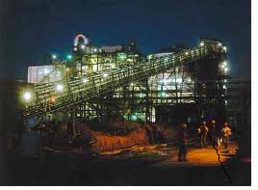
EPC Contracts
Sr. no. | Project Name | Client
6. | Aarti Drugs Ltd. (Ammonium Sulphate plant Automation on turnkey basis)
7. | Lupin Limited. Mandideep. (Lisinopryl Plant) C&I Detailed Eng. Supply & Erection of PLC based PLC HMI Interfaced Systeme

Slide 13
Oil and Gas Off Shore projects
Sr. no. | Project Name | Client
1. | BG Panna platform -Detailed Engineering of DCS
2. 3. | BG Panna & Tapti Main & Satellite platforms – Hazardous area classification layout. BG Panna & Tapti platforms –Detail engineering off CCTV System
4. | Panna Platform –Detailed Engineering Services for DCS
5. | Tapti Satellite: Piping Stress Analysis

Slide 14
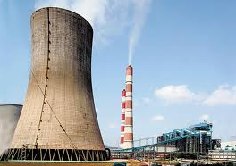
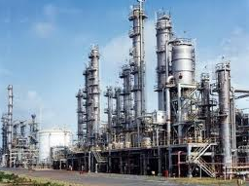


Nuclear Power Projects
Preparation of conceptual interlock wiring diagram and P & ID
2) Instrumentation Detailed Engineering services to produce detailed plant wiring drawings
Sr. No.0 | Project Name | Client
1. | Rajasthan Atomic Power Station -RAPP 3 & 4
2. | Madras Atomic Power project -MAPP 1 & 2
3. | Narora Atomic Power project -NAPP 1 & 2
4. | Kakrapara Atomic Power project -KAPP 1 & 2
6. | Tarapur Atomic Power project –TAPP 3 & 4

Slide 15
Nuclear Power Projects
Instrumentation field installation and commissioning
2) Fuelling machine Head Tubing for Total 20 NOS. Fuelling machine
Sr. No.0 | Project Name | Client
1. | Rajasthan Atomic Power Station -RAPP 3 & 4
2. | Tarapur Atomic Power project -TAPP 3 & 4
3. | Rajasthan Atomic Power Station –RAPP 5 & 6
4. | Tarapur Atomic Power project -TAPP 3 & 4
5 | Kudankulam Nuclear power project- KKNPP-1 & 2
6. | Supply of Manpower for operation of IT facility at Tarapur TAPP- 3 & 4

Slide 16

BHABHA ATOMIC REASERCH CENTRE
(BARC)
Nuclear Recycle group Tarapur
E& I Erection commissioning activities for following Project
Sr. No.0 | Project Name | Client
1. | AVS Plant ,Tarapur
2. | ROP Plant, Tarapur
3. | AWTF Plant , Tarapur
4. | SFSF Plant, Tarapur
5 | Annual Maintainance & Plant Modification In PREFPRE – 1 & 2
6 | NFC Plant, Tuticorin, Tamilnad
7. | ECIL-Kalpakam-Erection & Instrumentation work field instrument & SS Tubing

Slide 17



Pharma Chemical projects
Sr. no. | Project Name | Client
1. | Aarti Drugs Ltd. (Methyle, Midzol sulphate, Metro Nidzol, Cipro, Q-Acid) with PLC based Flow Ratio Control system
2. | RPG Life Sciences Ltd. / Searle India Ltd. (Vitamin B2, B12, Multipurpose fermentation plant) C+I Engineering & Erection
3. | Ralis India ltd. (KRM Plant), PLC based PC HMI Intrfaced Syst.
4. | Lupin Limited. Tarapur C&I Detailed Engineering
5. | Lupin Limited. Mandideep. (Lisinopryl Plant) C&I Detailed Eng. Supply & Erection of PLC based PLC HMI Interfaced Syst.
6. | Wokhard Limited, Ankaleshwar (Multipurpose plant) C & I Detailed Eng & Erection work
7. | National Peroxide plant, Ambivali (Hydrogenation & Peroxide project) C&I Detailed engineering & Erection work
8. | Salvigor Laboratories. C&I Detailed engineering & Erection work.

Slide 18


Man-made Fiber Plant
Sr. no. | Project Name | Client
1. | Reliance Limited. Patalganga (PSA Hydrogen Purification plant / PTA Pneumatic conveying ) –Engineering , Errection and Supply of PLC Based PlC HMI Interfaced Control System
2. | Reliance PFY plant. Patalganga. -Detailed Engineering , Erection Services for Instrumentation
3. | FCI (Shanghai) / Chemtex . PET & PTL plant. – Detailed Engineering.
4. | Polygenta Technologies Limited. ( Polyester plant, PET to PTA conversion plant) – Detailed Engineering Instrumentation & Electrical
5. | Terene Fiber India Ltd. (Batch plant modernisation project, Continuous plant modernisation project) –Engineering , Errection and Commissioning

Slide 19





Chemical plant projects
Sr. no. | Project Name | Client
1. | Cheminova –P2 plant
2. | Cheminova DCS revamping.
3. | India Glyoxol Ltd. MEG plant
4. | Andhra Petrochemicals (Oxy Alcohol plant)
5. | BASF India. (Multipurpose plant)
6. | BASF E&I turn key projects at Nalagarh & Turbhe
7. | Saudi / Chemtex (Methanol plant)
8. | Godrej Ltd. (Alpha Olefins plant)
9. | Saudi / Kilburn Ltd. (Liquid & Gas drying system)
10. | Khamam Refineries, Chemplant (48 Sections instrument control panel Engineering)

Slide 20

Fertilizer Plant Projects
Sr. no. | Project Name | Client
1. | Aarti Drugs Ltd. (Ammonium Sulphate plant Automation on turnkey basis)
2. | Ralis India ltd. Lote. (KRM project, Argo chemicals plant) Plant Automation on Turnkey basis.
3. | RCF Trombay, Sindri (Nitric acid plant Denox plant) Detailed Engineering & Erection work of C & I System
4. | RCF Thal (Burner management for Oxy. plant),
5. | K.P.R. Fertilizers (Sulphuric Acid plant) – Turnkey instrumentation
6. | Fertiplant Malaysia (Granulation plant FIR C.C.M.A)
7. | Bhogavati Sahakari Khat Udyog Ltd. (Super phosphate and Ammonium Sulphate plant)

Slide 21

Soap / Detergent / Fatty acid / Breweries / Food
Sr. no. | Project Name | Client
1. | Breweries plant - L & T at Daman and Aurangabad
2. | Hindustan Liver Ltd, Khamgaon (Soap Plant)
3. | Tomco Gaziabad (Fatty acid plant)
4. | Burn Philp India (Yeast manufacturing plant)
5. | A. M & P Roha Sulphonation plant.

Slide 22
Colour / Paints / Pigments / Intermediate
Sr. no. | Project Name | Client
1. | Heubach Colour, Ankaleshwar (Greeen, Blue plant)
2. | ICI Surfactant plant (DCS Engineering)
3. | Wacker Metropack Chem. Co. Ltd. (Silicon oil & Emulsion plant)
4. | BASF Mangalore (Eukesolar plant)
5. | ICI Uniqema, Thane (PF 10 plant)
6. | Conmix India (Ready mix plaster plant)

Slide 23

Specialty Chemicals
Sr. no. | Project Name | Client
1. | Monarch Catalyst, Dombivali (Nickel Catalyst Plant) (Hydrogen & Nickel Carbonate Plant) (PSA Plant)
2. | Filtra Catalyst plant, Chiplun (3-5 XYLINOL Automation)
3. | FMC Hyderabad (N-Butyl Lithium project)
4. | HB Fuller India Adhesives Pvt. Ltd. (Specialty Adhesives Plant)

Slide 24



Water & Effluent treatment projects
Sr. no. | Project Name | Client
1. | KBL, Pune (Tirupur water supply project)
2. | Tamilnadu water supply (Madras water supply project)
3. | Sardar Sarovar K & L Line (Water pipeline project)
4. | Tamilnadu water supply (Water treatment plant)
5. | BASF Turbhe. Effluent treatment plant
6. | ONGC Mehesana. Produced water treatment plant - Engineering
7. | Ministry Of Housing, Electricity & Water Sultanate Of Oman (MSSI) - PLC , SCADA Engineering and supply. Water Supply to Bahla Wilayat. Water Supply to Ash Sharqiyah. Water Supply to BID-BID FANJA and Cities around Water Supply to Liwa, Saham, Khaburah and Shinas Water Supply to Al Amirat

Slide 25

Aviation fuel, Oil and Grease plant
Sr. no. | Project Name | Client
1. | IOCL Vashi (Automation of Grease plant)
2. | IOCL Silvassa (Automation of Oil blending plant)
3. | IOCL Kolkata (Automation of Oil blending plant)
4. | IOCL Sahar (Aviation fuel pressurized hydrant Automation)
5. | IOCL Trombay (Automation of Oil blending plant)
6. | IOCL Silvassa (Consultancy for infrastructure Augmentation)
7. | IOCL Silvassa (Piping Electrical & instrumentation contracts)
8. | IOCL, Storage Infrastructure Augmentation at LBP Silvassa (Electrical & instrumentation contracts)

Slide 26


Optical Fiber Erection Jobs
Sr. no. | Project Name | Client
1. | IOBL- IOCL LUBE OIL PIPE LINE SCADA WITH OPTICAL FIBER MODEM CONNECTIVITY
2. | IOBL COMPLEX OPTICAL FIBER LAN Office Automation
3. | Reliance Engineering Fiber Optic Cable proving work in Patna
4. | RMEC OFC Hyderabad project

Slide 27
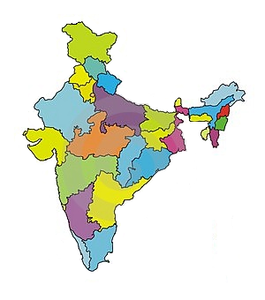
Projects in India
Himachal Pradesh
Nalagarh
Rajasthan
Kota
Harayana
Faridabad
Gujrat
Mehesana
Gandhinagar
Vadodara
Ankaleshwar
Vapi
Silvassa
Dhanora
Kakrapara
Uttar Pradesh
Narora
Bihar
Patna
Madhya Pradesh
Bhopal
Mandideep
Maharashtra
Tarapur
Thane
Wada
Nashik
Nagpur
Aurangabad
Mumbai
Uran
Taloja
Pune
SataraShirwal
Chiplun
Roha
Patalganga
Satara
Chandrapur
West Bengal
Kolkata
Andhra Pradesh
Hyderabad
Vishakhapattanam
Rajahmundry
Tamilnadu
Kudankulam
Chennai
Tuticorin
Kalpakkam
Karnataka
Bangalore
Mangalore
Kaiga

Slide 28


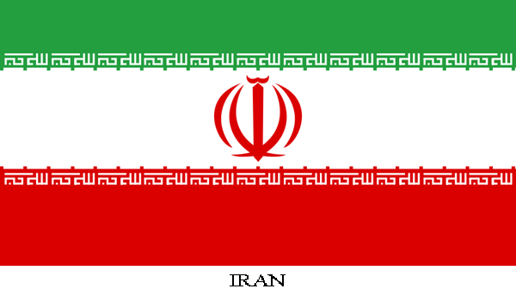




Abroad Projects
Oman
Mustafa Sultan Science & Industries CO. LLC.
Iran
Ralis Chemicals Ltd.
Kuwait
ATSCO
Malaysia
Fertiplant Engineering
Nigeria
R. P. Eng. Pvt. Ltd.
Bangladesh
Dorsch consultant

Slide 29

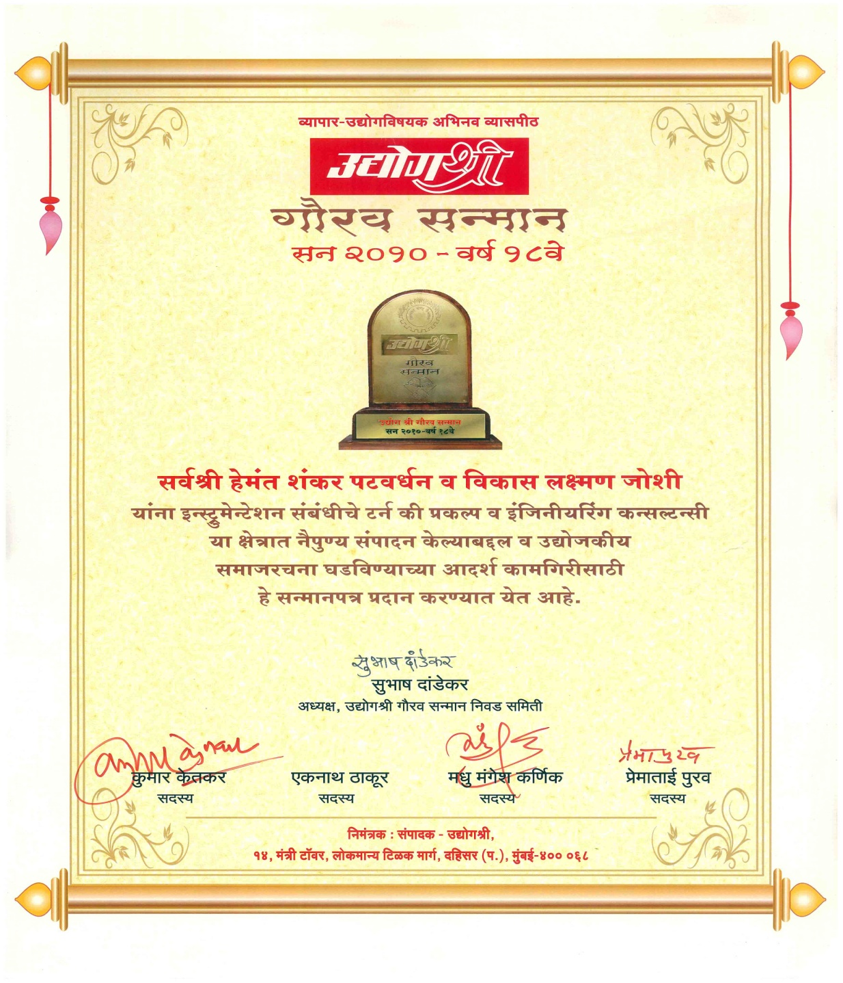

Slide 30
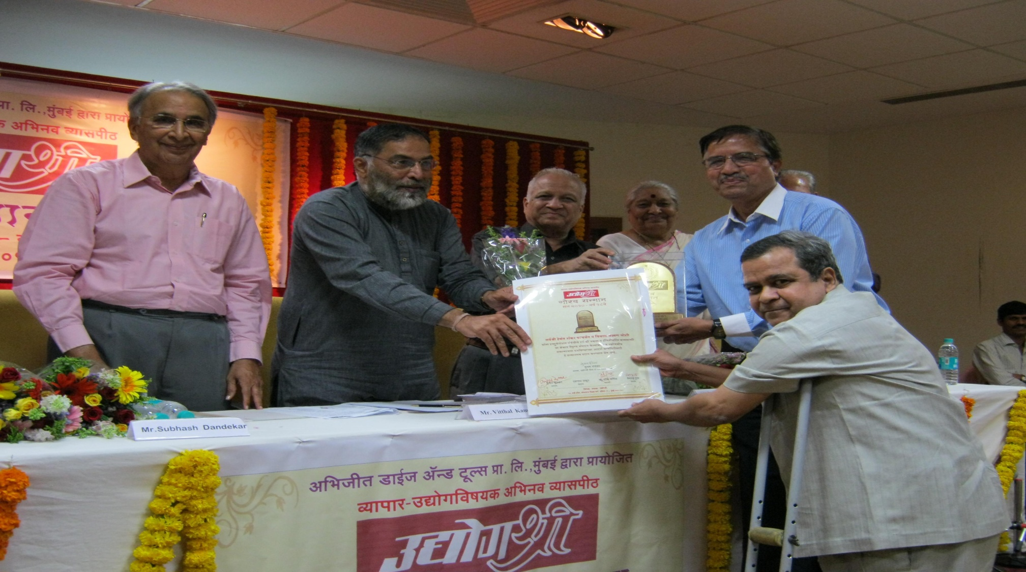
“]VaogaEaI”

Slide 31
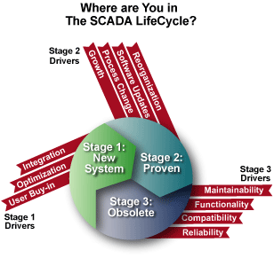

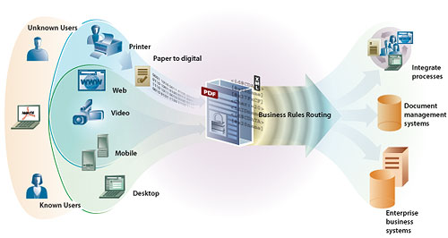

Thank You
E-mail: - fsoias@gmail.com
Phone: +91-22-29275926, 29275928
Fax: +91-22-29275925

